Slide 1
Backpropagation
Instructor: Dr. Yan Yan

Slide 2
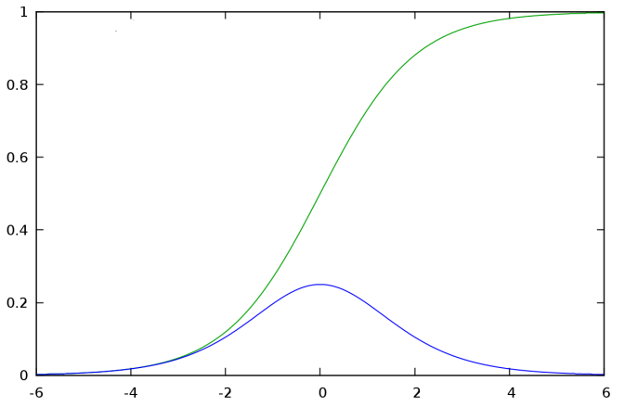












Backpropagation – Backward pass
Compute ${∂l}/{∂z}$ for all activation function inputs z
$$w_{1}$$
$$z$$
$$a$$
$$x_{1}$$
$$a=σ\left(z\right)$$
$$w_{2}$$
b
$$x_{2}$$
$$σ\left(z\right)$$
$$\frac{∂l}{∂z}$$
$$=\frac{∂a}{∂z}\frac{∂l}{∂a}$$
$$σ′\left(z\right)$$
$$σ′\left(z\right)$$

Slide 3






Backpropagation – Backward pass
Compute ${∂l}/{∂z}$ for all activation function inputs z
$$w_{1}$$
$$z$$
$$a$$
$$w_{3}$$
$$z′$$
$$x_{1}$$
$$a=σ\left(z\right)$$
$$z′=aw_{3}+⋯$$
$$w_{2}$$
b
$$w_{4}$$
$z$’’
$$x_{2}$$
$$\frac{∂l}{∂z}$$
$$=\frac{∂a}{∂z}\frac{∂l}{∂a}$$
$$\frac{∂l}{∂a}=\frac{∂z′}{∂a}\frac{∂l}{∂z′}+\frac{∂z′′}{∂a}\frac{∂l}{∂z′′}$$
(Chain rule)
Assumed it’s known
?
?
$$w_{3}$$
$$w_{4}$$

Slide 4



Backpropagation – Backward pass
Compute ${∂l}/{∂z}$ for all activation function inputs z
$$w_{1}$$
$$z$$
$$a$$
$$w_{3}$$
$$z′$$
$$x_{1}$$
$$\frac{∂l}{∂z}$$
$$\frac{∂l}{∂z′}$$
$$w_{2}$$
b
$$w_{4}$$
$z$’’
$$x_{2}$$
$$\frac{∂l}{∂z′′}$$
$$\frac{∂l}{∂z}=σ′\left(z\right)\left[w_{3}\frac{∂l}{∂z′}+w_{4}\frac{∂l}{∂z′′}\right]$$
Notes:
How to explain this chain rule

Slide 5
Backpropagation – Backward pass
Compute ${∂l}/{∂z}$ for all activation function inputs z
$$w_{1}$$
$$z$$
$$a$$
$$w_{3}$$
$$z′$$
$$x_{1}$$
$$\frac{∂l}{∂z}$$
$$\frac{∂l}{∂z′}$$
$$w_{2}$$
b
$$w_{4}$$
$z$’’
$$x_{2}$$
$$\frac{∂l}{∂z′′}$$
$$\frac{∂l}{∂z}=σ′\left(z\right)\left[w_{3}\frac{∂l}{∂z′}+w_{4}\frac{∂l}{∂z′′}\right]$$

Slide 6
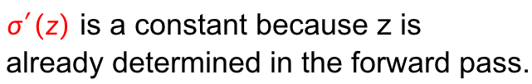

Backpropagation – Backward pass
$$σ′\left(z\right)$$
$$w_{3}$$
$$\frac{∂l}{∂z}$$
$$\frac{∂l}{∂z′}$$
$$w_{4}$$
$σ′\left(z\right)$ is a constant because z is
already determined in the forward pass.
$$\frac{∂l}{∂z′′}$$
$$\frac{∂l}{∂z}=σ′\left(z\right)\left[w_{3}\frac{∂l}{∂z′}+w_{4}\frac{∂l}{∂z′′}\right]$$

Slide 7

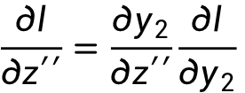
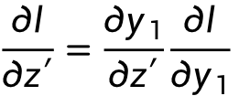

Backpropagation – Backward pass
Compute ${∂l}/{∂z}$ for all activation function inputs z
$$w_{1}$$
$$z$$
$$a$$
$$w_{3}$$
$$z′$$
$$x_{1}$$
$$y_{1}$$
$$\frac{∂l}{∂z}$$
$$\frac{∂l}{∂z′}$$
$$w_{2}$$
b
$$w_{4}$$
$z$’’
$$y_{2}$$
$$x_{2}$$
$$\frac{∂l}{∂z′′}$$
Case 1. Output Layer
$$\frac{∂l}{∂z′}=\frac{∂y_{1}}{∂z′}\frac{∂l}{∂y_{1}}$$
$$\frac{∂l}{∂z′′}=\frac{∂y_{2}}{∂z′′}\frac{∂l}{∂y_{2}}$$
Done!

Slide 8
Backpropagation – Backward pass
Compute ${∂l}/{∂z}$ for all activation function inputs z
Case 2. Not Output Layer
$$z′$$
…
$$\frac{∂l}{∂z′}$$
$z$’’
…
$$\frac{∂l}{∂z′′}$$

Slide 9







Backpropagation – Backward pass
Compute ${∂l}/{∂z}$ for all activation function inputs z
Case 2. Not Output Layer
$$z′$$
$$a′$$
$$w_{5}$$
$$z_{a}$$
$$\frac{∂l}{∂z′}$$
$$\frac{∂l}{∂z_{a}}$$
$$w_{6}$$
$z$’’
$$z_{b}$$
$$\frac{∂l}{∂z′′}$$
$$\frac{∂l}{∂z_{b}}$$

Slide 10
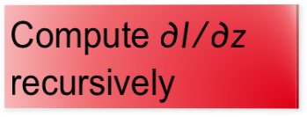

Backpropagation – Backward pass
Compute ${∂l}/{∂z}$ for all activation function inputs z
Case 2. Not Output Layer
Compute ${∂l}/{∂z}$ recursively
$$z′$$
$$a′$$
$$w_{5}$$
$$z_{a}$$
$$\frac{∂l}{∂z′}$$
$$\frac{∂l}{∂z_{a}}$$
$$σ′\left(z′\right)$$
Until we reach the output layer ……
$$w_{6}$$
$z$’’
$$z_{b}$$
$$\frac{∂l}{∂z′′}$$
$$\frac{∂l}{∂z_{b}}$$

Slide 11












Backpropagation – Backward Pass
Compute ${∂l}/{∂z}$ for all activation function inputs z
Compute ${∂l}/{∂z}$ from the output layer
$$\frac{∂l}{∂z_{1}}$$
$$\frac{∂l}{∂z_{3}}$$
$$\frac{∂l}{∂z_{5}}$$
$$z_{1}$$
$$z_{3}$$
$$z_{5}$$
$$y_{1}$$
$$x_{1}$$
$$x_{2}$$
$$y_{2}$$
$$z_{2}$$
$$z_{4}$$
$$z_{6}$$
$$\frac{∂l}{∂z_{2}}$$
$$\frac{∂l}{∂z_{4}}$$
$$\frac{∂l}{∂z_{6}}$$

Slide 12




Backpropagation – Backward Pass
Compute ${∂l}/{∂z}$ for all activation function inputs z
Compute ${∂l}/{∂z}$ from the output layer
$$\frac{∂l}{∂z_{1}}$$
$$\frac{∂l}{∂z_{3}}$$
$$\frac{∂l}{∂z_{5}}$$
$$z_{1}$$
$$z_{3}$$
$$z_{5}$$
$$y_{1}$$
$$x_{1}$$
$$σ′\left(z_{1}\right)$$
$$σ′\left(z_{3}\right)$$
$$σ′\left(z_{2}\right)$$
$$σ′\left(z_{4}\right)$$
$$x_{2}$$
$$y_{2}$$
$$z_{2}$$
$$z_{4}$$
$$z_{6}$$
$$\frac{∂l}{∂z_{2}}$$
$$\frac{∂l}{∂z_{4}}$$
$$\frac{∂l}{∂z_{6}}$$

Slide 13



Backpropagation – Summary
Forward Pass
Backward Pass
…
…
…
…
$$a$$
$$\frac{∂z}{∂w}$$
X
$$\frac{∂l}{∂z}$$
$$=\frac{∂l}{∂w}$$
$$=a$$
for all w

